Slide 1
CREDIT CARD FRAUD DETECTION
USING MACHINE LEARNING
Guided by : Dr. R. R. Suman
Group No.: 40
Team Members
Ankesh 2021UGCS058
Betha Sushma 2021UGCS120

Slide 2
Title
Problem Statement
Introduction
Objectives
Dataset
Algorithm Used
Logistic Regression
K-Nearest Neighbour
Decision Tree
Results
Future Work
References
TABLE OF CONTENTS

Slide 3
PROBLEM STATEMEMNT
Developing a machine learning model which should be capable of effectively detecting fraudulent transactions within credit card systems

Slide 4
INTRODUCTION
In a landscape where financial security is paramount, the detection and prevention of credit card fraud stand as pivotal challenges.
Given the impact of fraudulent activities on individuals and financial institutions, the ability to accurately forecast and mitigate such risks is of utmost importance.
Our objective is to leverage machine learning techniques to provide robust solutions for credit card fraud detection.
NumPy, Pandas, Matplotlib, Sklearn and many more form the foundation of our project. These libraries empowered us to manipulate data, build models and visualize results effectively.

Slide 5
OBJECTIVES
Data Collection and Preprocessing: Collect comprehensive datasets containing historical credit card transaction data from reputable sources.
Feature Selection: Identify pertinent features within the transactional data that may serve as indicators of fraudulent activity.
Model Selection and Implementation: Evaluate a range of machine learning algorithms tailored for fraud detection tasks.
Visualization: Utilize visualization tools to present the findings of the project in a clear and comprehensible manner.

Slide 6
DATASET
The data of credit card transactions made by European Card Holders was used for the model training.
It was accessed from https://www.kaggle.com/datasets/mlg-ulb/creditcardfraud
This dataset presents transactions that occurred in two days, where we have 492 fraud out of 2,84,807 transactions.
It contains features like Time, Amount of Transaction, Class, v1, v2, …, v28.
It contains only numerical input variables which are the result of PCA transformation.

Slide 7
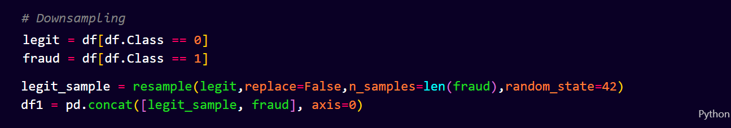
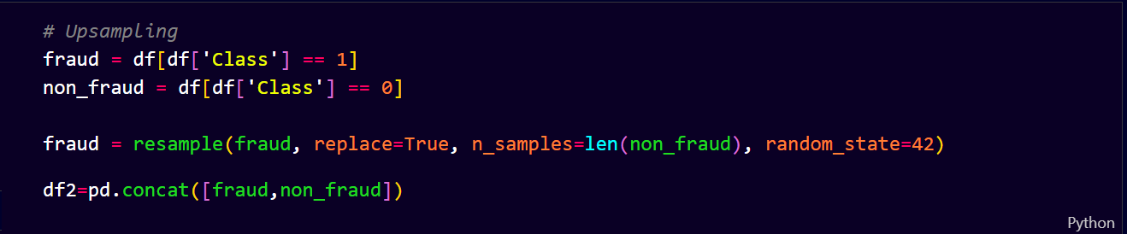
Since the dataset is unbalanced, down sampling and up sampling of data is done.
Down Sampling:
Up Sampling:

Slide 8
ALGORITHMS USED
Three algorithms were applied on the data set:-
Logistic Regression
K-Nearest Neighbours (KNN)
Decision Tree
Each algorithms were applied on the up sampled and down sampled data.

Slide 9
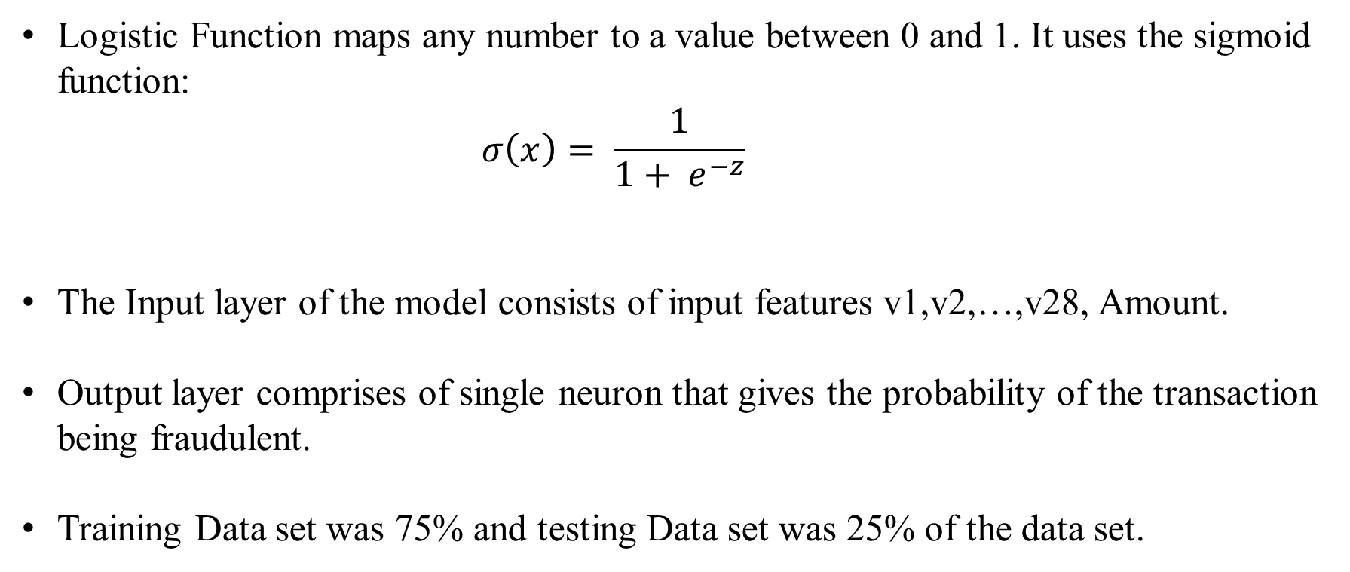
Logistic Regression
Logistic Function maps any number to a value between 0 and 1. It uses the sigmoid function:
$$σ\left(x\right)= \frac{1}{1+ e^{−z}}$$
The Input layer of the model consists of input features v1,v2,…,v28, Amount.
Output layer comprises of single neuron that gives the probability of the transaction being fraudulent.
Training Data set was 75% and testing Data set was 25% of the data set.

Slide 10
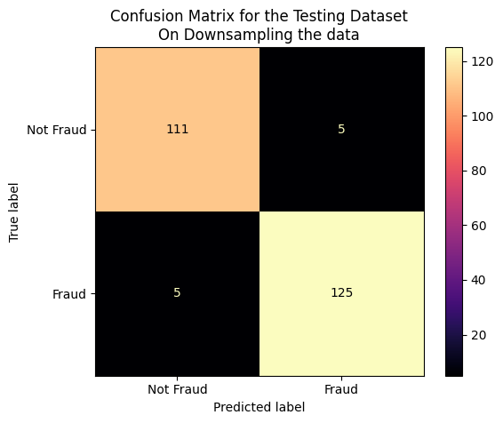
Logistic Regression
It was applied on the Down Sampled Data. It’s results are:-
No. of Correct Predictions :
236
No. of Wrong Predictions :
10
Accuracy : 95.93%

Slide 11
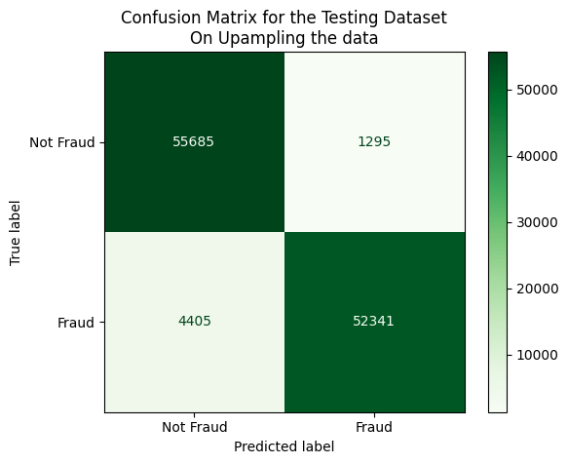
Logistic Regression
It was applied on the Up Sampled Data. It’s results are:-
No. of Correct Predictions :
1,08,026
No. of Wrong Predictions :
5700
Accuracy : 94.98%

Slide 12
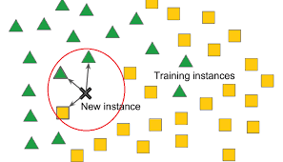
K-Nearest Neighbour (KNN)
KNN relies on the similarities between data points in a feature space. It operates by selecting the k nearest neighbours of a given data point based on the computed distances.
The Input layer of the model consists of input features v1,v2,…,v28, Amount.
Output layer comprises of single neuron that gives the probability of the transaction being fraudulent.
Training Data set was 75% and testing Data set was 25% of the data set.

Slide 13
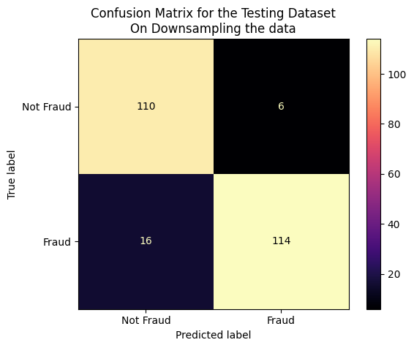
K-Nearest Neighbour (KNN)
It was applied on the Down Sampled Data. It’s results are:-
No. of Correct Predictions :
224
No. of Wrong Predictions :
22
Accuracy : 91.06%

Slide 14
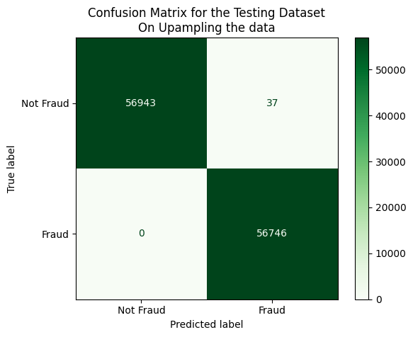
K-Nearest Neighbour (KNN)
It was applied on the Up Sampled Data. It’s results are:-
No. of Correct Predictions :
1,13,689
No. of Wrong Predictions :
37
Accuracy : 99.96%

Slide 15
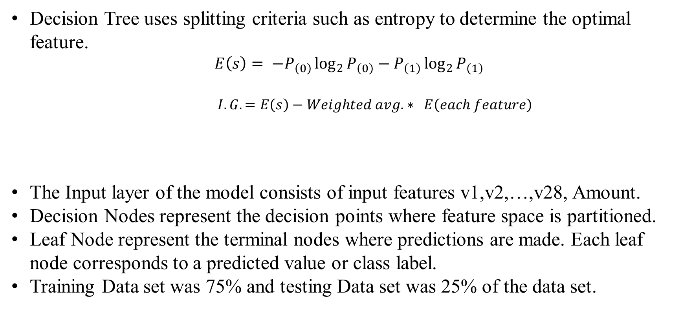
Decision Tree
Decision Tree uses splitting criteria such as entropy to determine the optimal feature.
$$E\left(s\right)= −P_{\left(0\right)}\log_{2}{P_{\left(0\right)}}−P_{\left(1\right)}\log_{2}{P_{\left(1\right)}}$$
$I.G. =E\left(s\right)−Weighted avg. ∗ E\left(each feature\right)$
The Input layer of the model consists of input features v1,v2,…,v28, Amount.
Decision Nodes represent the decision points where feature space is partitioned.
Leaf Node represent the terminal nodes where predictions are made. Each leaf node corresponds to a predicted value or class label.
Training Data set was 75% and testing Data set was 25% of the data set.

Slide 16
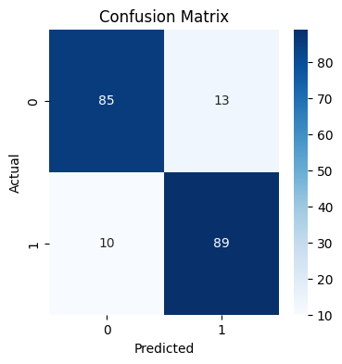
Decision Tree
It was applied on the Down Sampled Data. It’s results are:-
No. of Correct Predictions :
174
No. of Wrong Predictions :
23
Accuracy : 88.32%

Slide 17
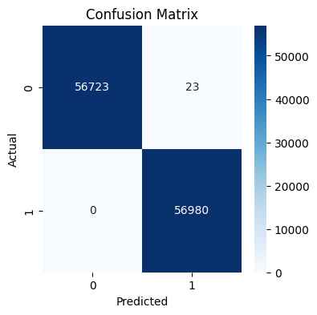
Decision Tree
It was applied on the Up Sampled Data. It’s results are:-
No. of Correct Predictions :
1,13,703
No. of Wrong Predictions :
23
Accuracy : 99.97%

Slide 18
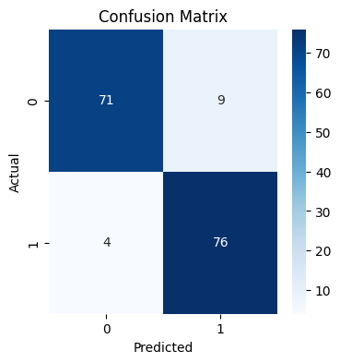
Decision Tree
It was applied on selecting 400 random samples from both classes randomly. Model was trained using 640 data points and tested on 160 data points. It’s results are:-
No. of Correct Predictions :
147
No. of Wrong Predictions :
13
Accuracy : 91.88%

Slide 19
RESULTS
Accuracy
Algorithms Used

Slide 20
SCOPE FOR FUTURE WORK
Increase in Accuracy and lowering of wrong predictions are required for enhancement.
Algorithms of Artificial Neural Networks and Deep Learning can be applied to increase the performance of the model.
Refinements in model architecture, coupled with a comprehensive analysis of unexplored factors, could further fortify its predictive capacity.

Slide 21
REFERENCES
Credit Card Fraud Detection using Machine Learning Algorithms by Vaishnavi Nath Dornadula et. Al. (2019)
Enhanced Credit Card Fraud Detection based on attention mechanism and LSTM deep model by Ibtissam Benchaji et. Al. (2021)
Credit Card Fraud Detection using hierarchical behavior-knowledge space model by Asoke K. Nandi et. Al. (2022)
Credit Card Fraud Detection by Munira Ansari et. Al. (2021)
Dataset Used – Credit Card Fraud Detection:
https://www.kaggle.com/datasets/mlg-ulb/creditcardfraud

Slide 22
THANK
YOU!

